Slide 1
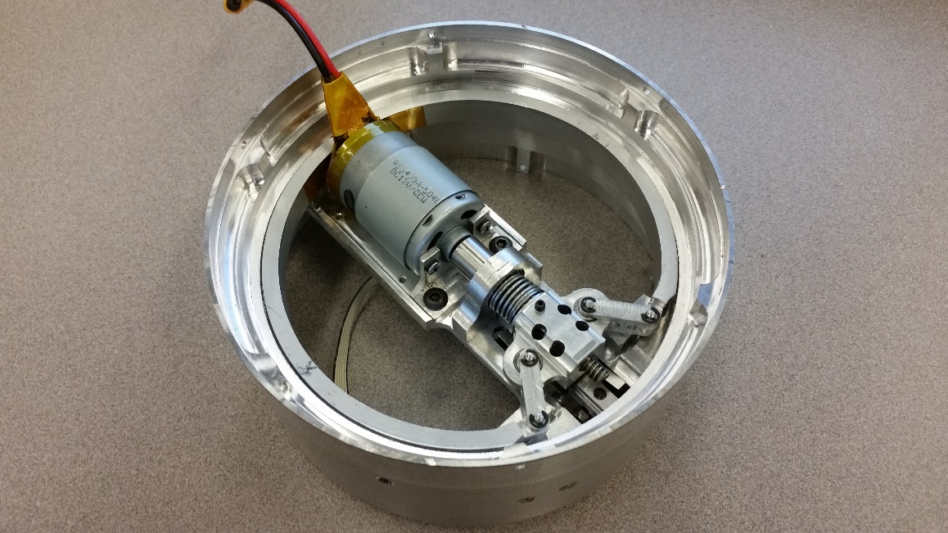
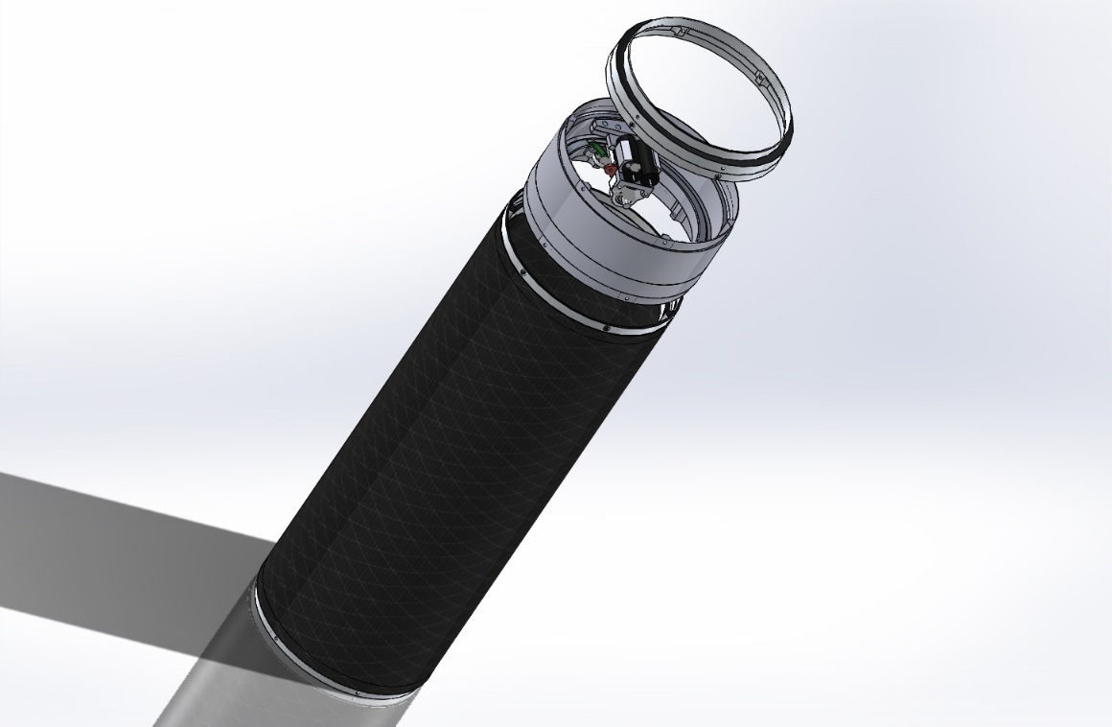
PSAS Nosecone Separation Ring
Miles Atherly, Ben Butler, Andrew Eads, Jason Hamilton, Brian Happ, Alin Resiga
Adviser: David Turcic

Slide 2
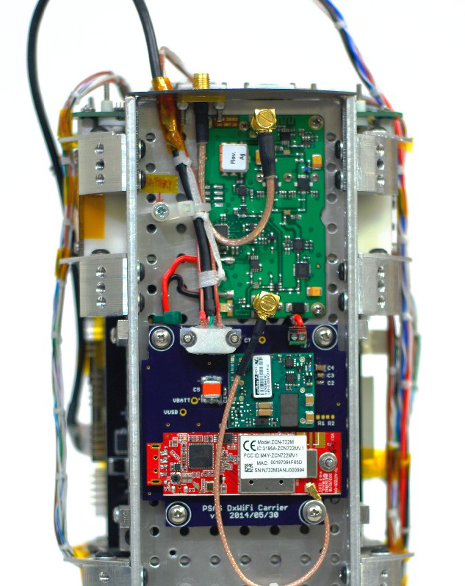
Why This Project is Awesome
One of only two entirely electro-mechanical NSR devices in existence (to our knowledge)
This will be the only electro-mechanical NSR device in use by an amatuer rocket club
Significant challenges in both design and manufacturing
Used many facets of engineering to complete the project

Slide 3
Overview
Project Details
Design Challenges
Design Process
Prototyping
Manufacturing
Conclusions

Slide 4
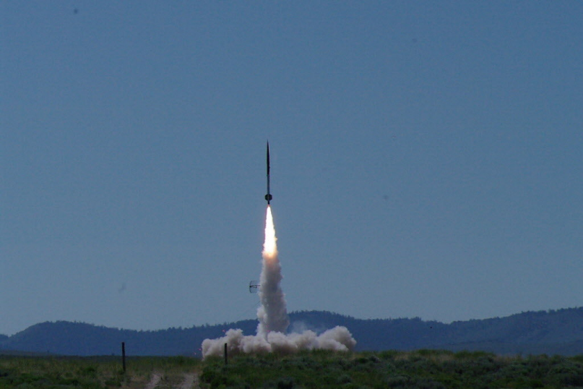
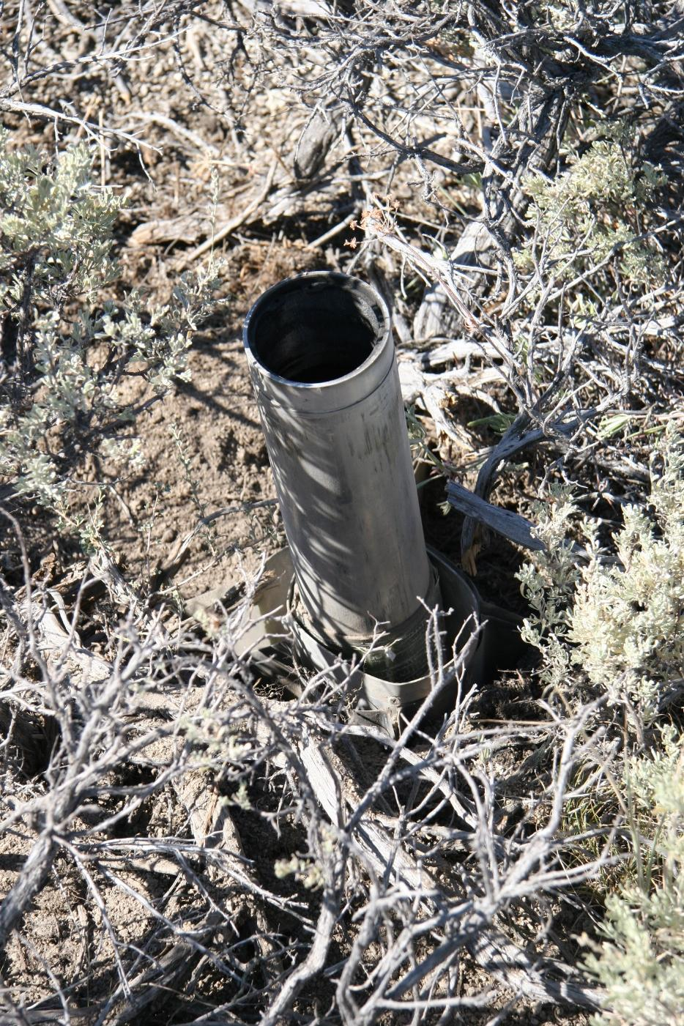
Nosecone Separation
Deploys parachute
Previous NSR used cyanoacrylate as an adhesive and gunpowder as the actuator
Very difficult to test for reliability
Failure destroys rocket

Slide 5
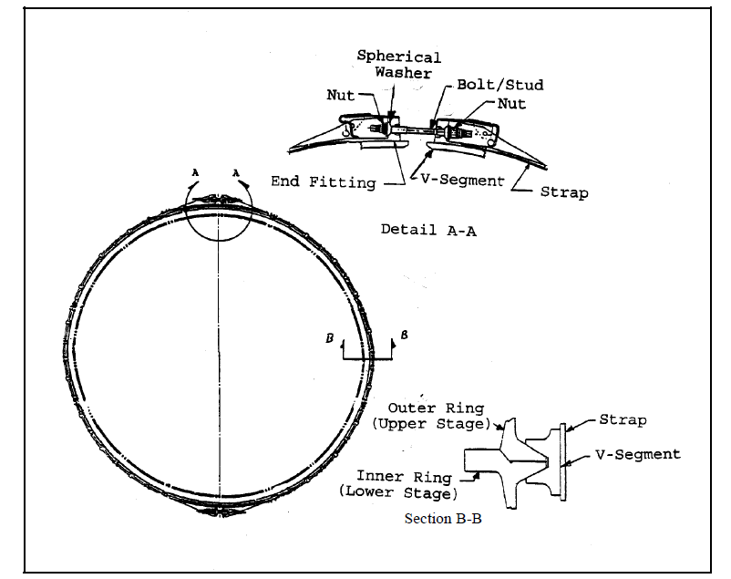
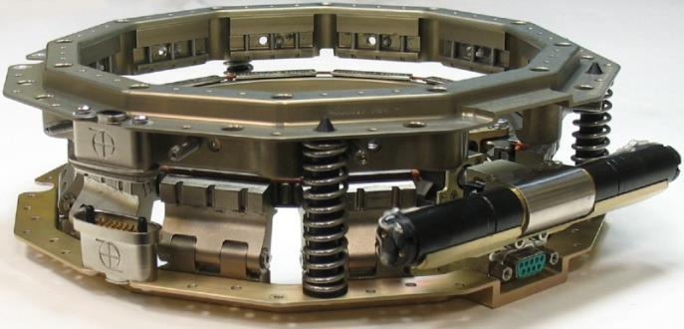
Inspiration
Marmon Clamp
LightbandTM

Slide 6
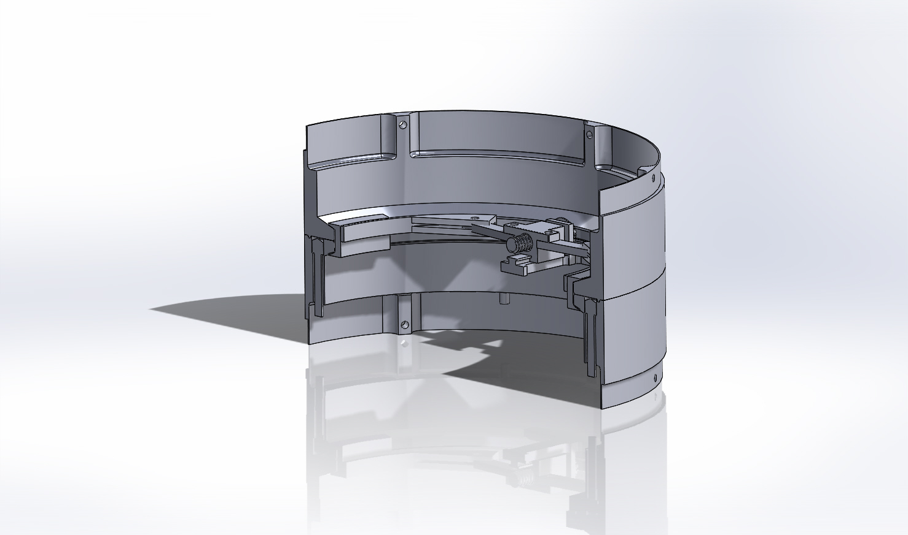
Design Challenges
Entire device must fit inside 6” diameter ring
Needs to be fast and be robust
Torque / power requirements
Isolation of components to avoid axial loading of motor

Slide 7
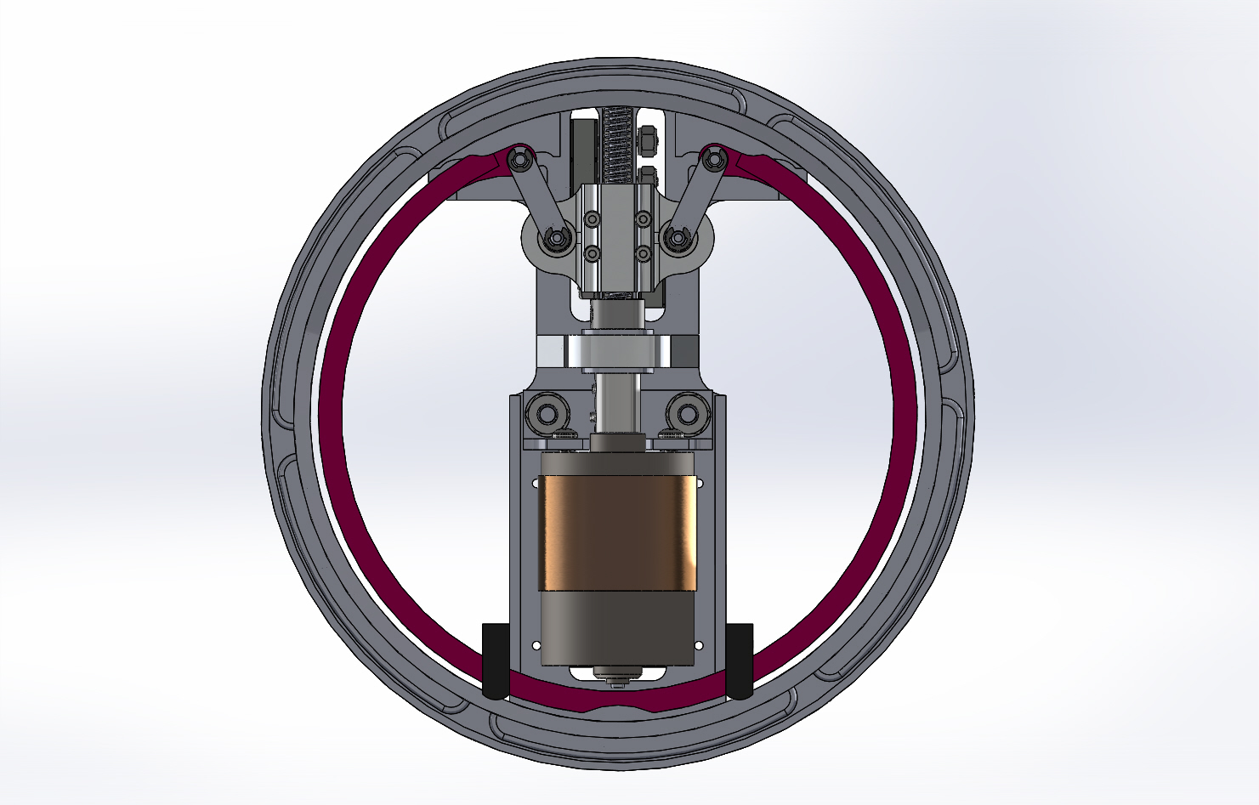
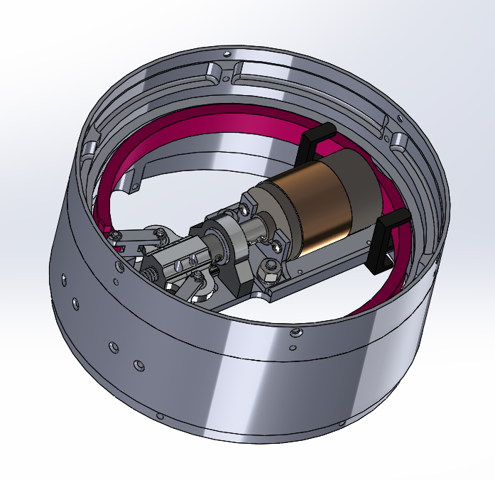
Final Solid Model

Slide 8
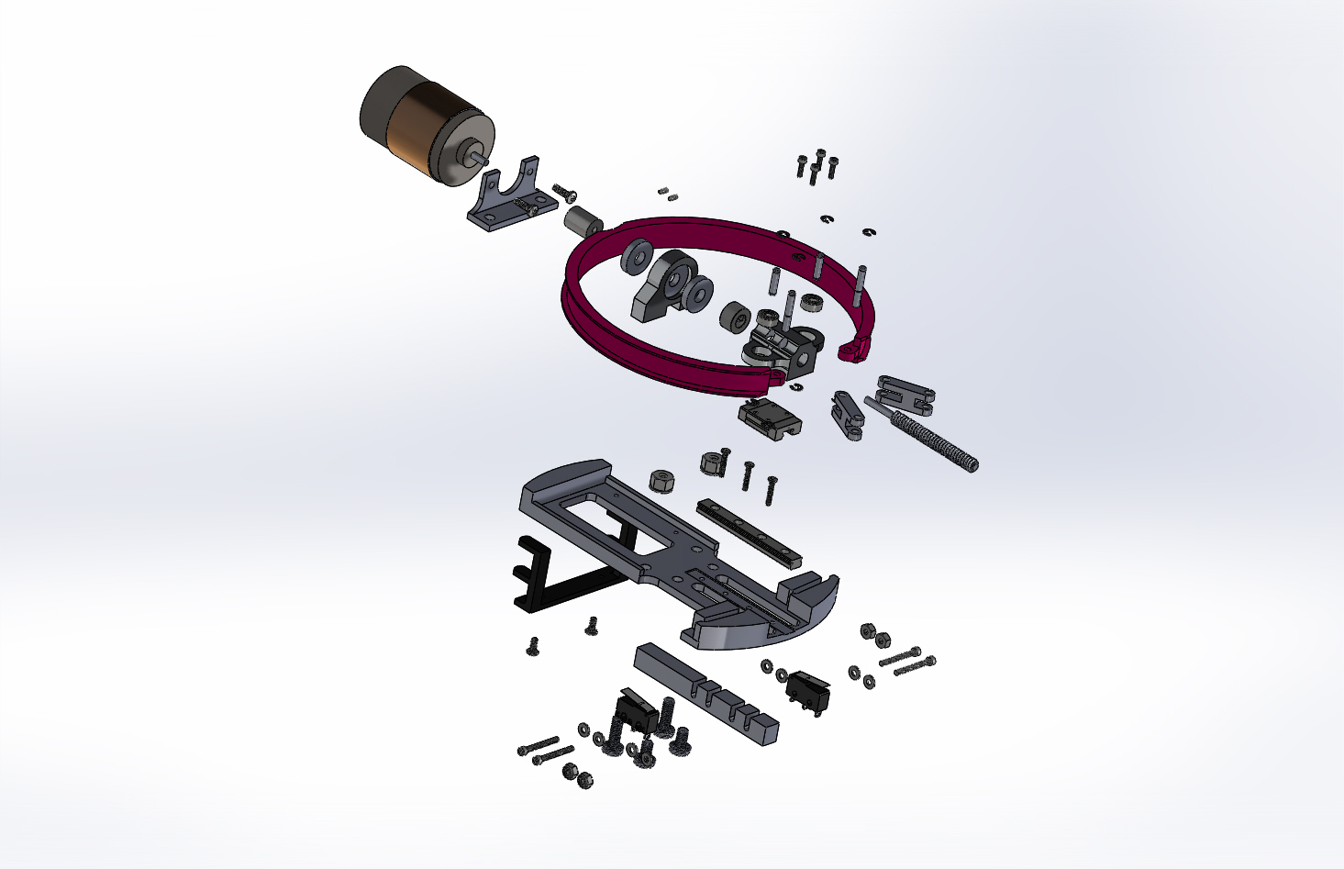

Slide 9
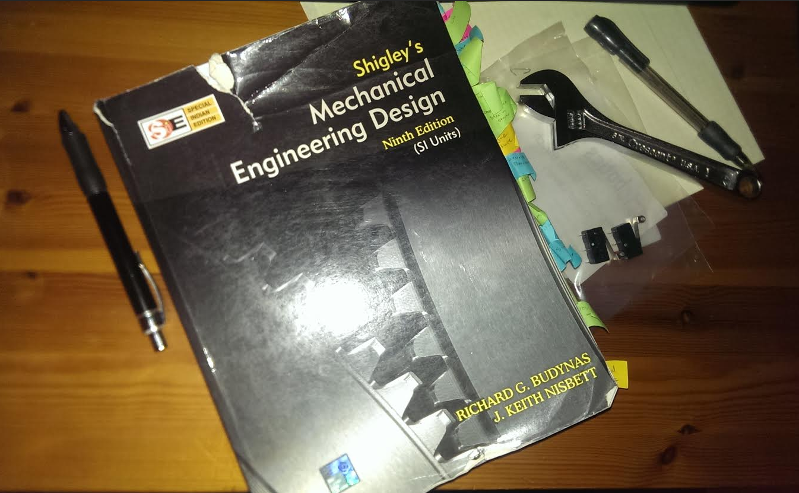
Analysis Based Design
Used mathematical modeling, FEA, and real world testing on components under high stress loads
Used statics, dynamics, vibrations, machine design and CAD software to assist in the design of moving parts and support structure

Slide 10
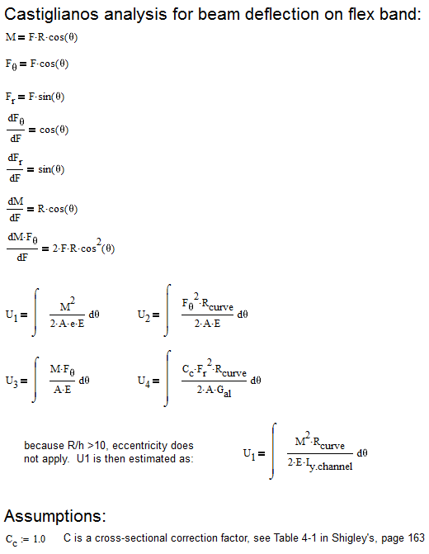
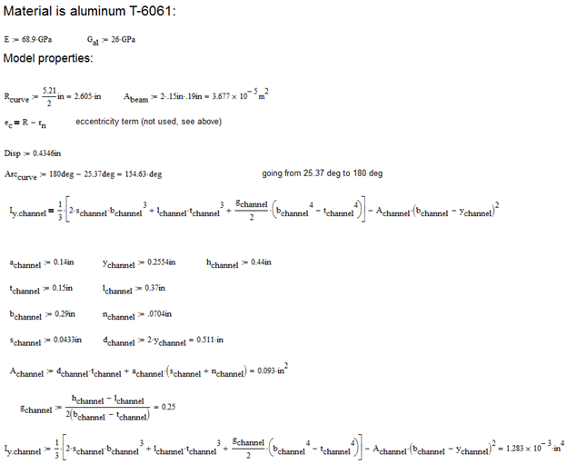
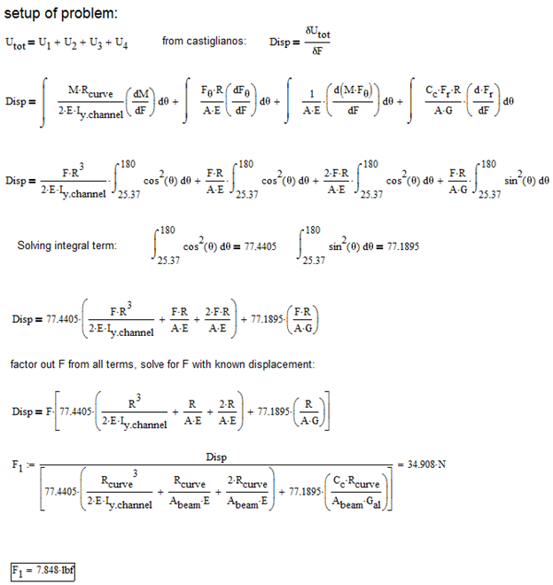
V-Band Optimization

Slide 11
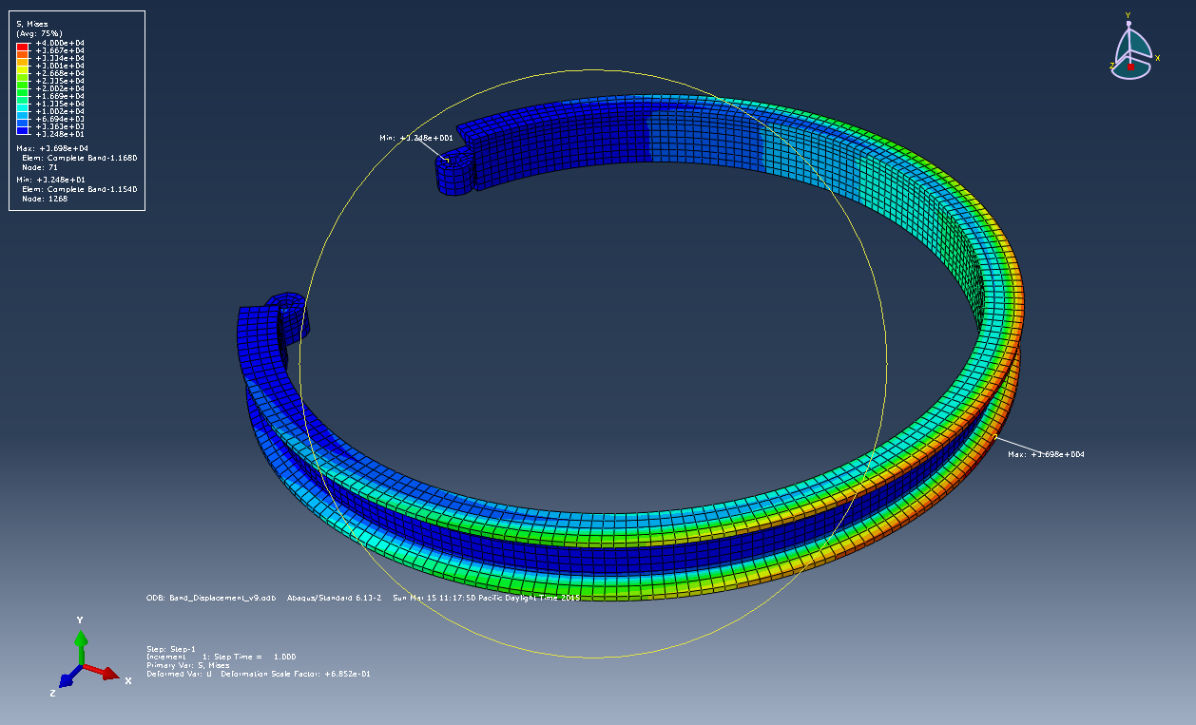
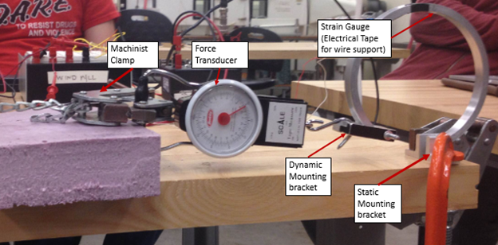
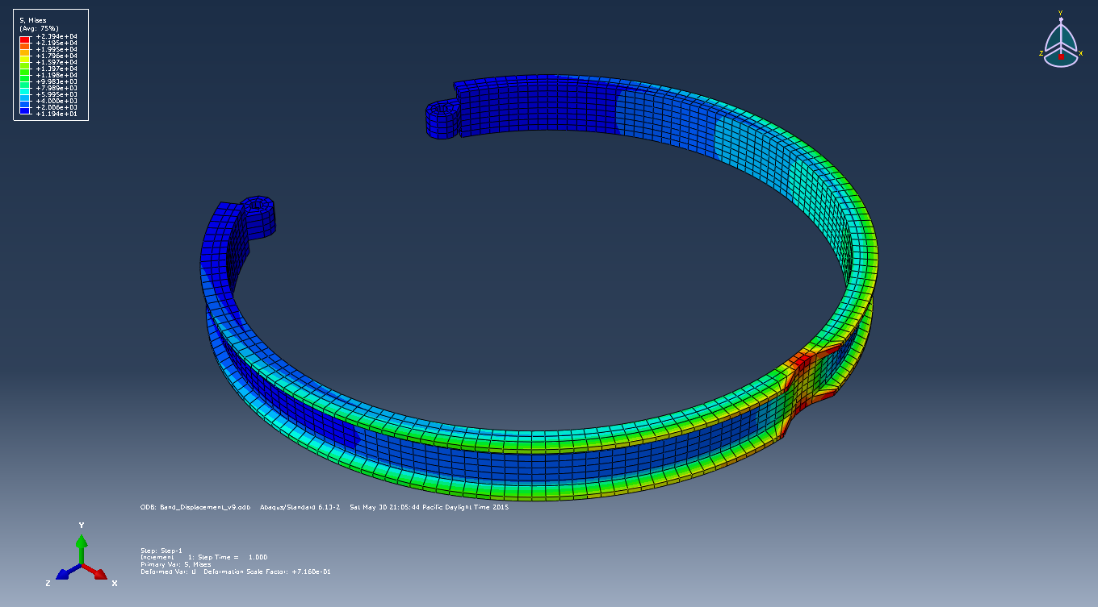
Model | Stress (psi) | Force Predicted (lbf)
Mathematical (Original) | NA | 18.2
Mathematical (Optimized) | NA | 15.68
Experimental | 37520 | 20.6
FEA (Original) | 36980 | 20.6
FEA (optimized) | 22866 | 16

Slide 12
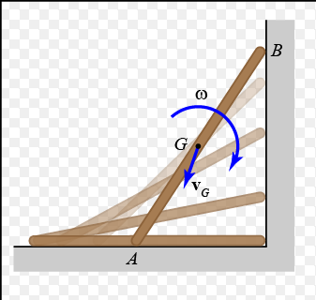
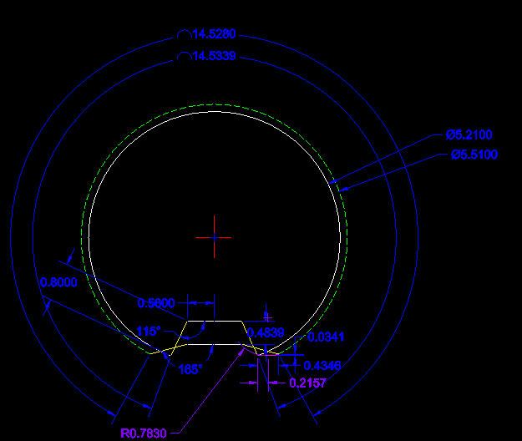
Design of Dynamic Action
Model using rigid body kinematics
End point (A) is equal to distance traveled by (B) plus rotation about part center

Slide 13
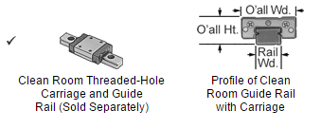
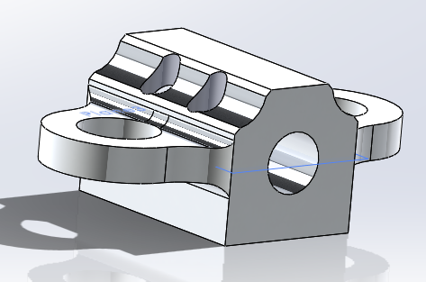
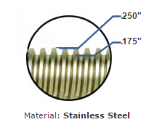
Linear Motion Constraint
Linear motion obtained using Guide rail and Power screw
Guide rail assembly eliminates most friction and has 300 lbf dynamic load capacity
Used needle thrust bearings to prevent transmission of axial load to motor

Slide 14
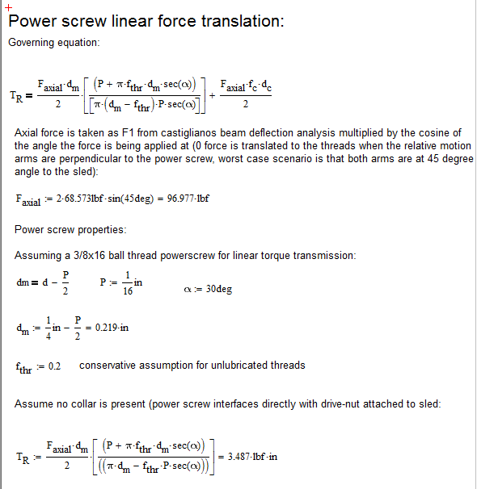
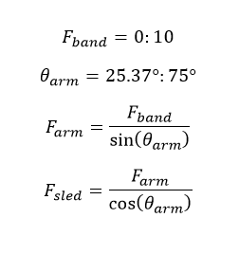
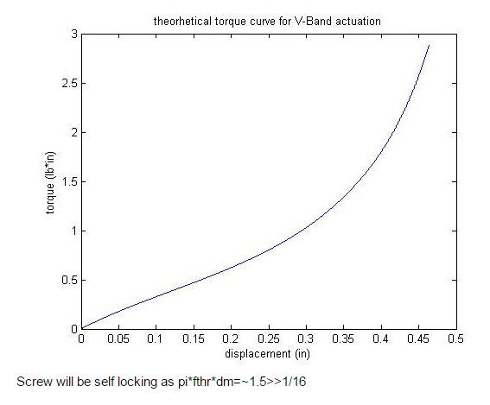
Power Requirements

Slide 15
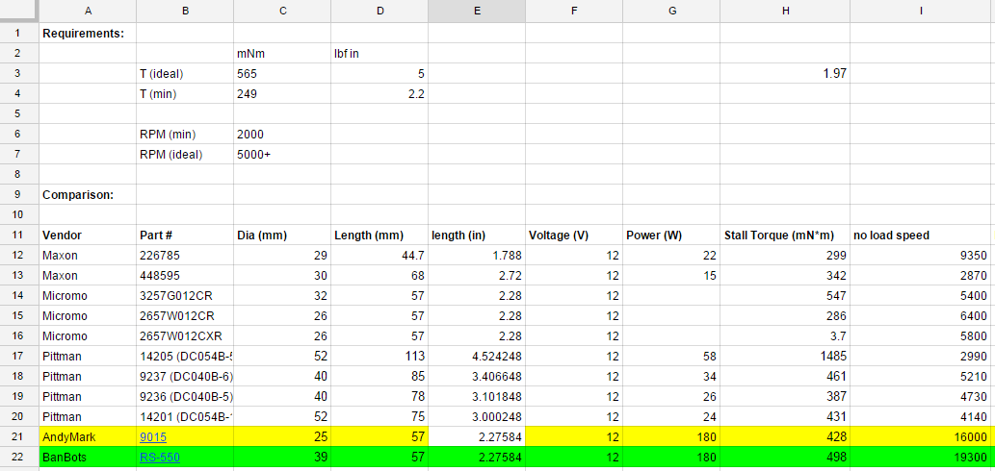
Motor Selection
stall torque = 498 mNm
speed = 19300 RPM
(no load)
dimensions fit nominal for direct drive
total cost: $7.00 (does not include shipping and handling)

Slide 16
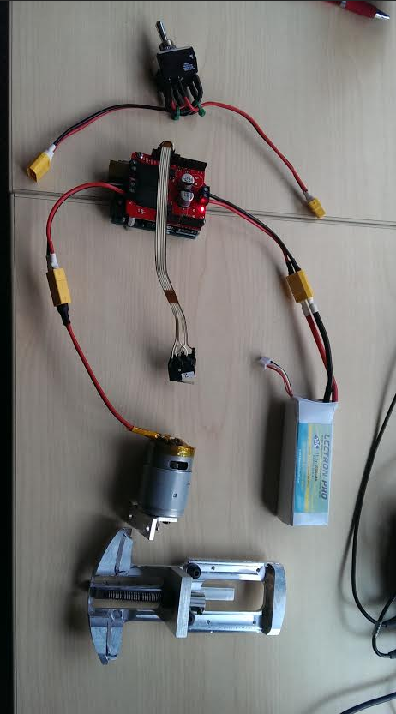
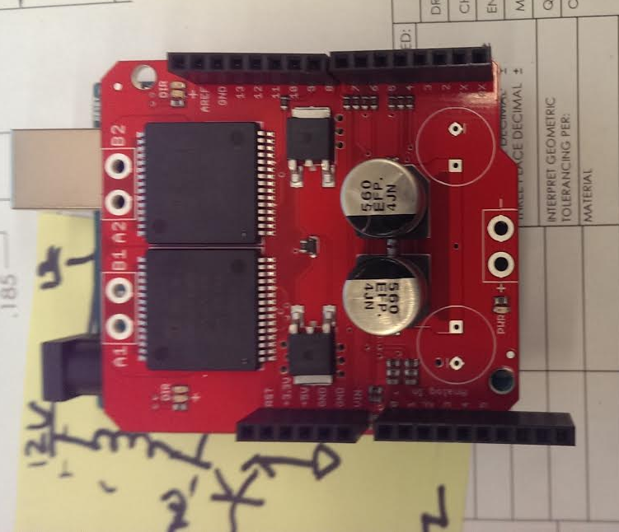
Electrical System (Prototype)
Motor controlled by PWM via Arduino equipped with 30A H Bridge
Push button operation (for display)
Limit switches used as fore and aft stops
Proprietary control board which interfaces with flight computer will be developed for use in LV3 vehicle

Slide 17
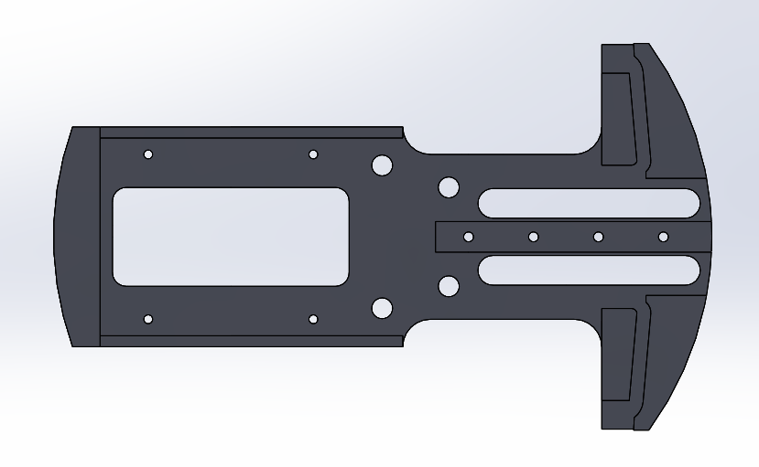
How to Incorporate it All?
-.002/-.004 Diameter Control Surface and Mounting Holes
Limit Switch Channels
Motor Profile Relief Cut
Precision Rail Slot and Fixturing Holes
1.5” x 1.5” 4-40 UNF-2B Mounting Hole Pattern for Electronics
Motor and Journal Mounting Holes
Relative Motion Guide Channels

Slide 18
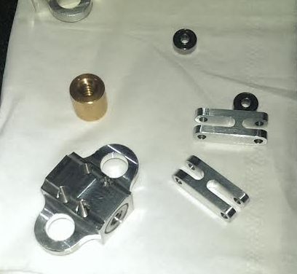
Design Notes
All parts designed with ½” or ¼” tooling in mind (where allowable) for manufacturing
Linear actuator parts must hold tight tolerancing to eliminate unwanted play. This was achieved by sizing and cutting the parts to each other
Custom couplers and pins were manufactured due to space constraints

Slide 19
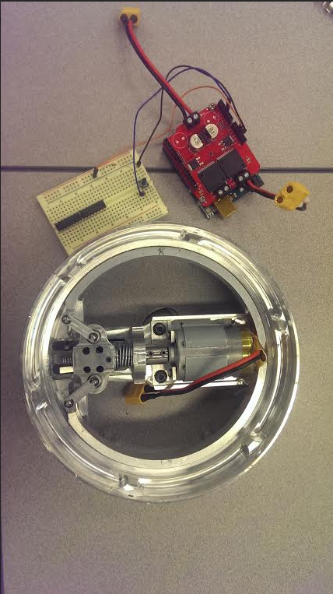
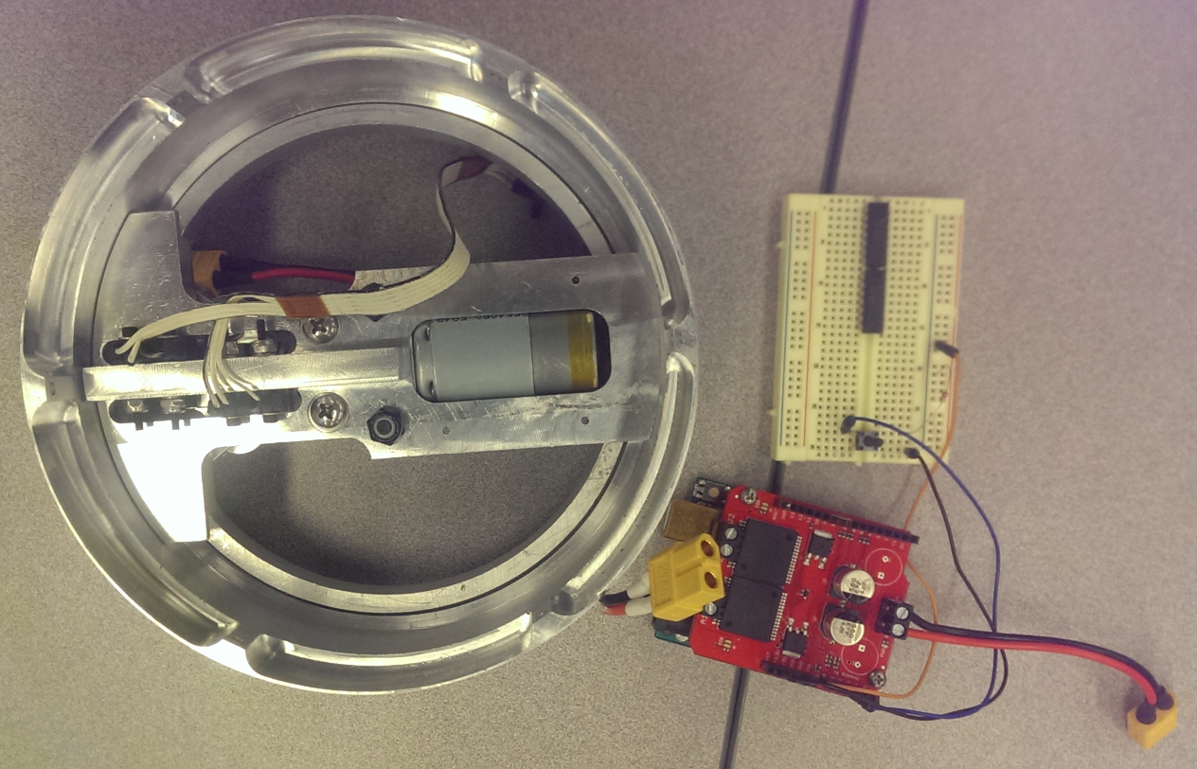

Slide 20
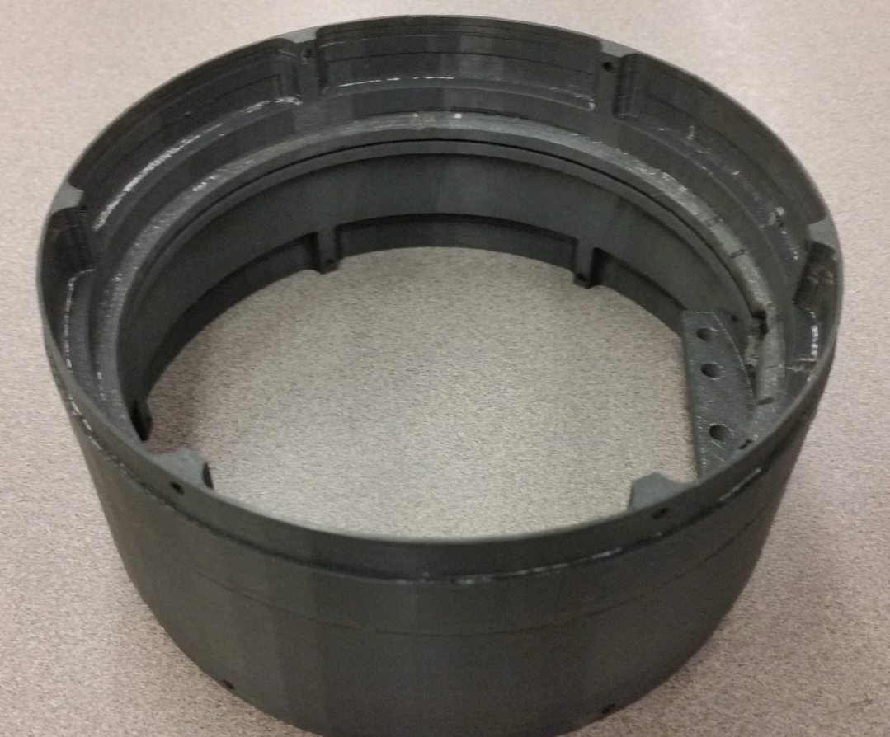
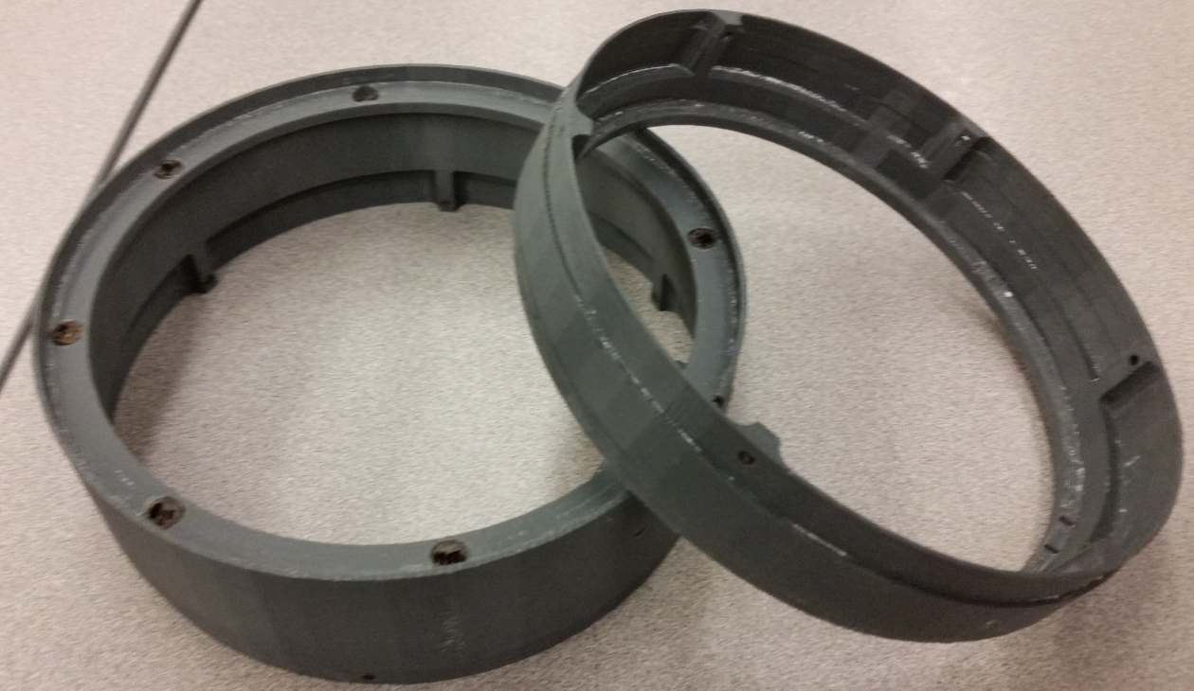
Prototyping: Coupling Rings

Slide 21
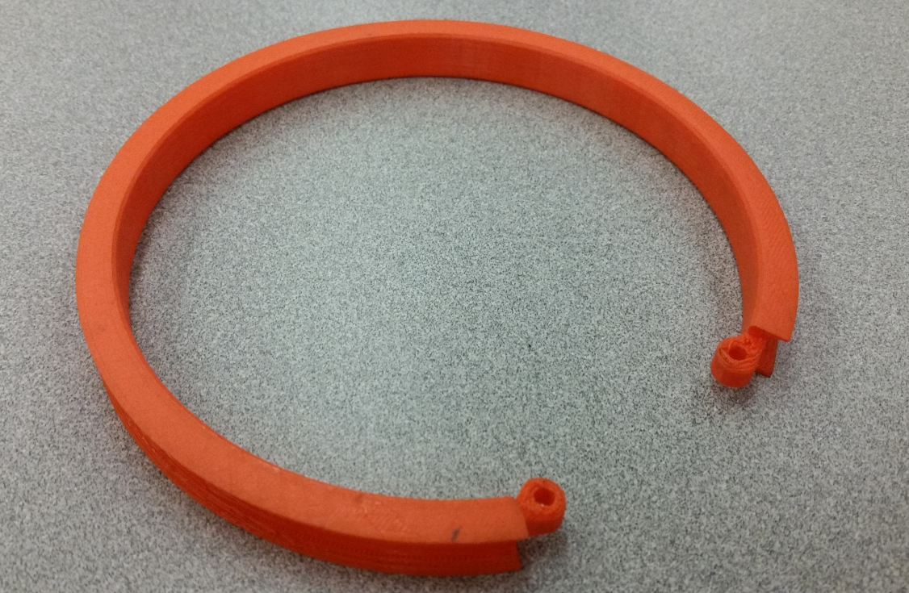
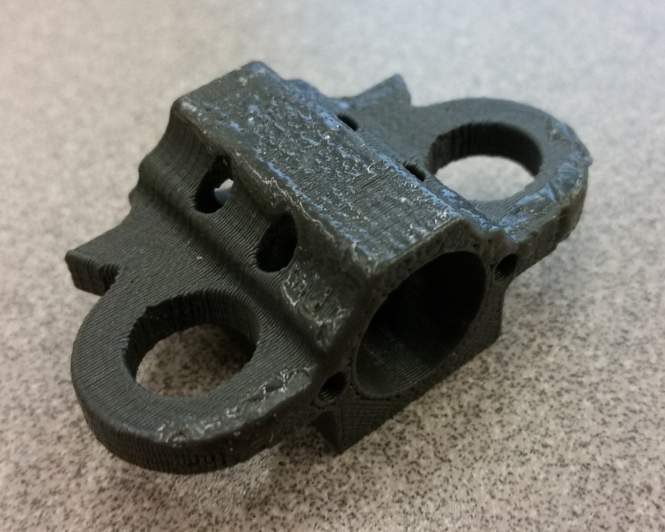
V-Band
Carriage

Slide 22
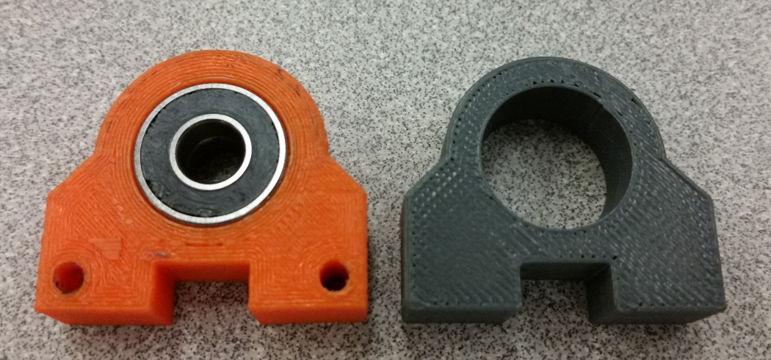
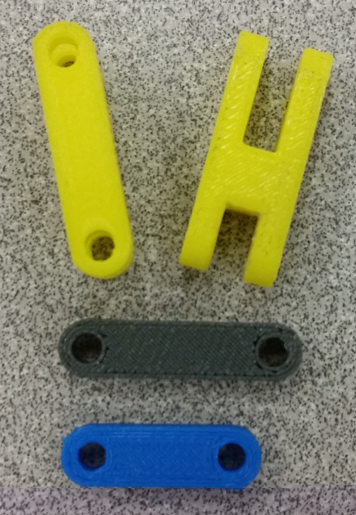
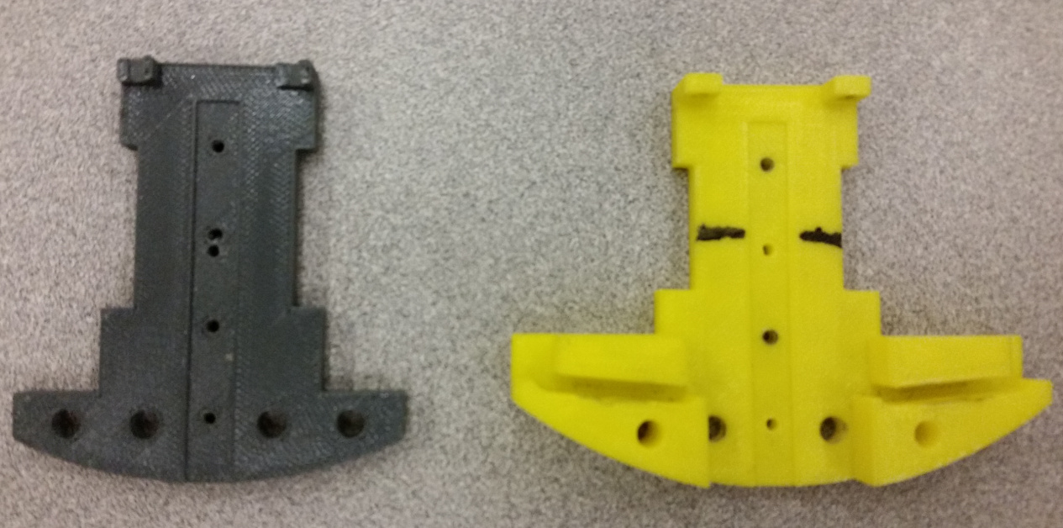
Journal
Arms
Baseplate

Slide 23


Slide 24
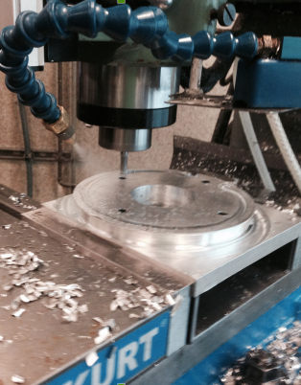
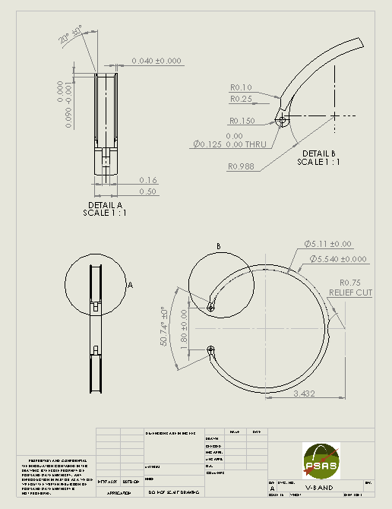
Machining
V-Band
Used 2-axis CNC to mill OD
Turned 20deg clamping surface with custom tool
Cut ID and relief cut with 2-axis

Slide 25
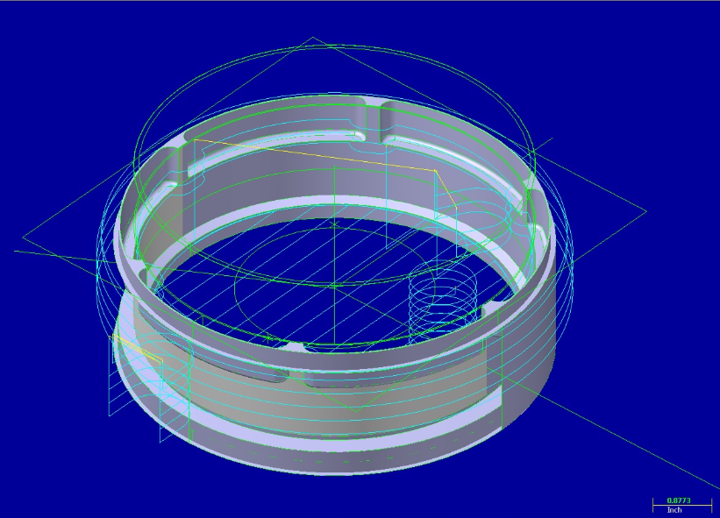
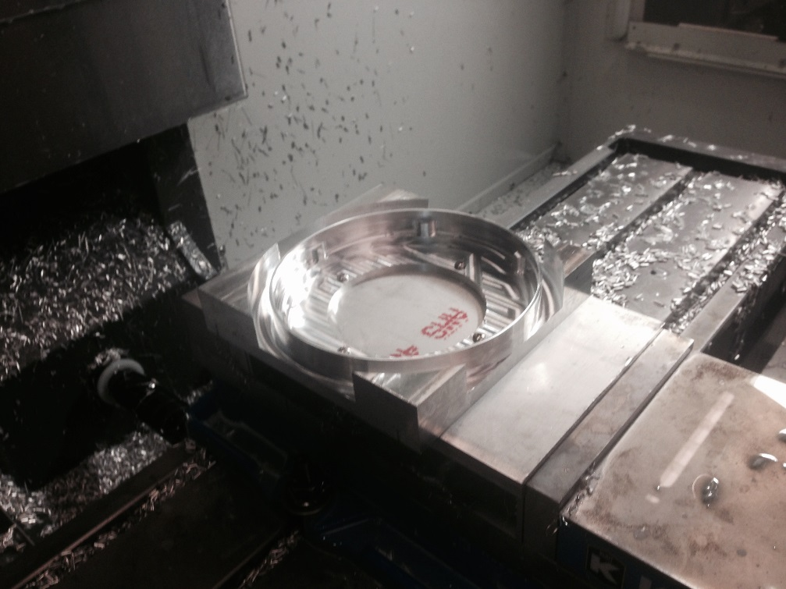
Large and Small Rings
Used Mastercam to define tool paths and write G code.
Machined using 3-axis Haas mill
Started with solid aluminum stock
Challenges:
20 deg chamfer to interface with v-band
1/8” fillet
Flipped part over several times

Slide 26
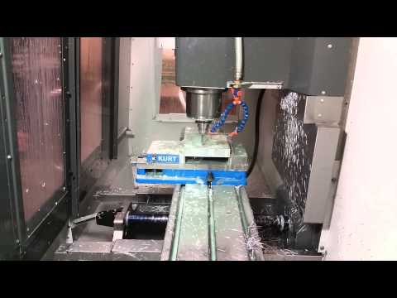

Slide 27
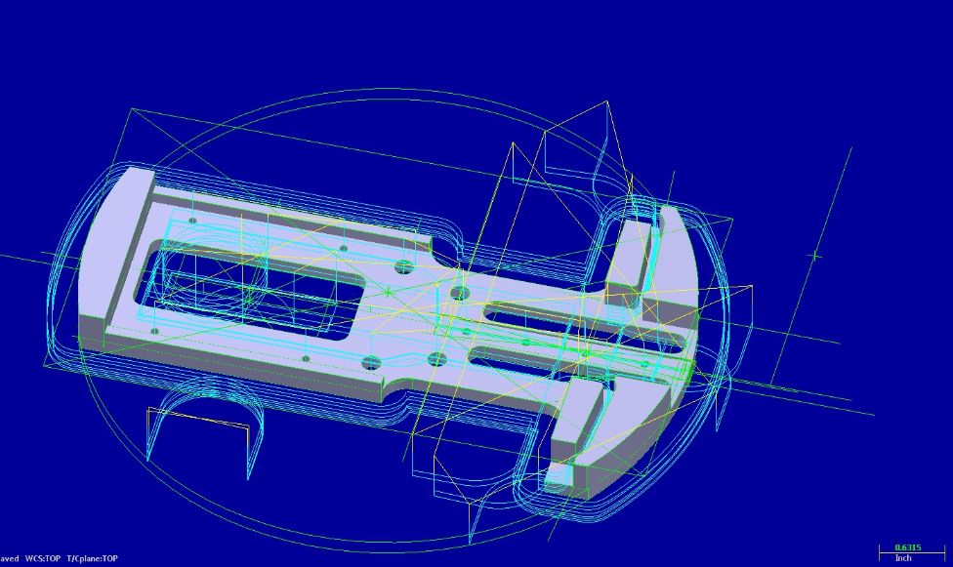
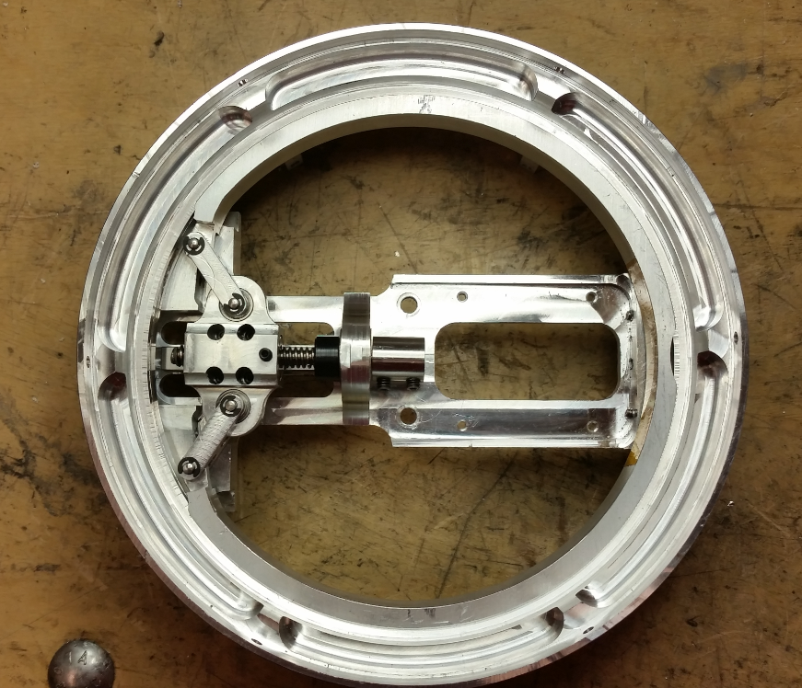
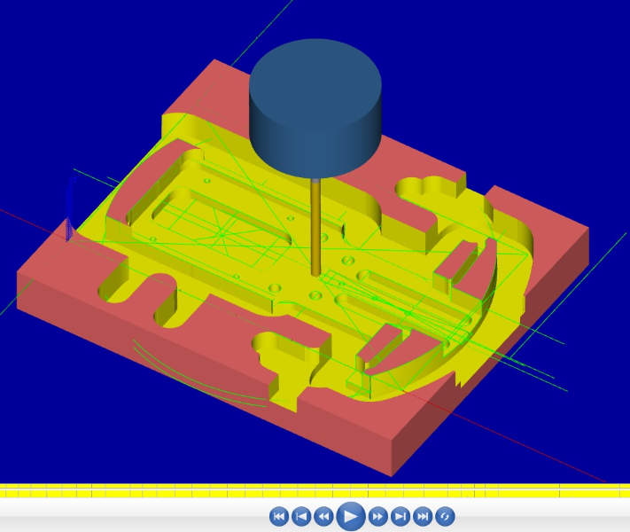
Baseplate
Machined on 3-axis Haas from 1/2” plate
Significant challenges in fixturing
1/8” and .110” channels

Slide 28
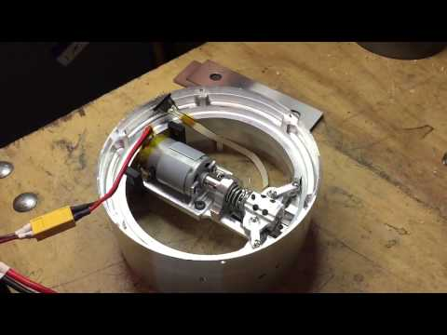

Slide 29
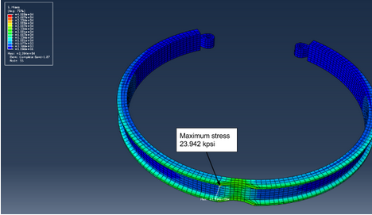
Fatigue
PDS Requirement: Mechanical failure of less than 1%.
24 kpsi is maximum stress on the system.
Fatigue analysis shows V-band could be actuated 44,000 times.

Slide 30
Conclusions
Mechanical components are rocket ready
Design can withstand a 250 lbf tensile load required by PDS
Actuates in ~63 milliseconds
Needs more robust electrical system

Slide 31

Questions?

